Slide 1
SE305 Database System Technology
Quiz-3

Slide 2
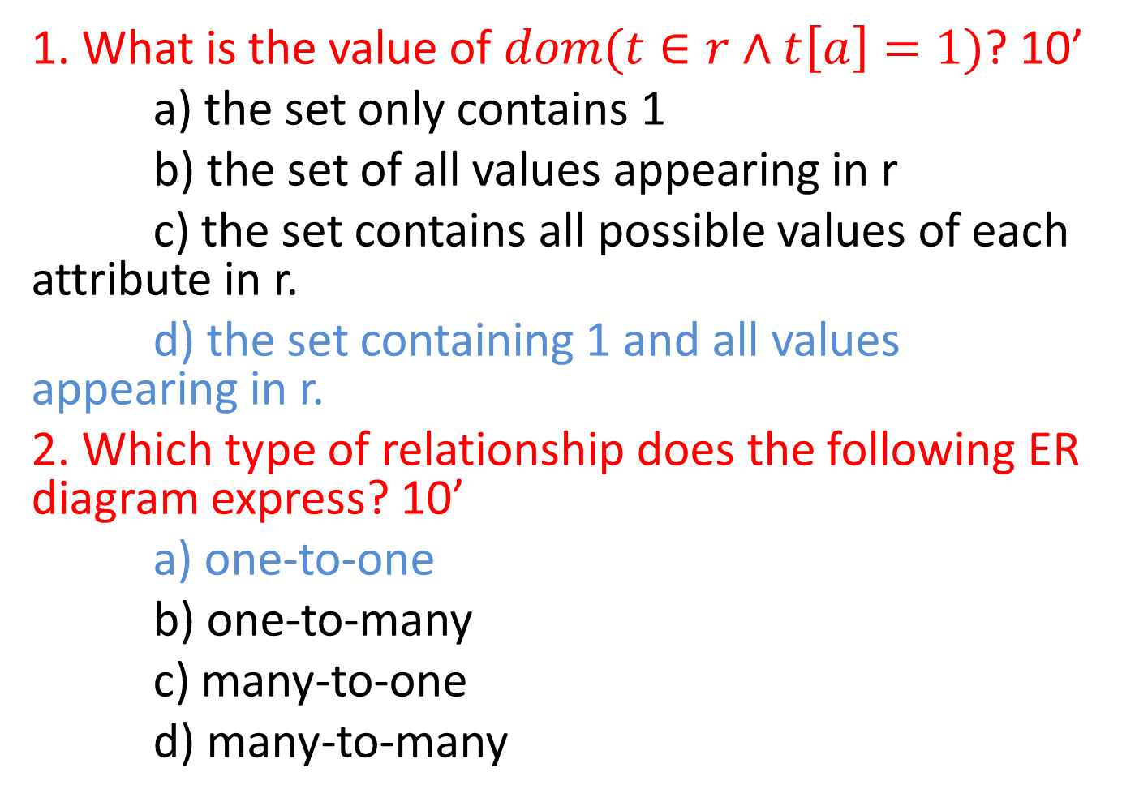
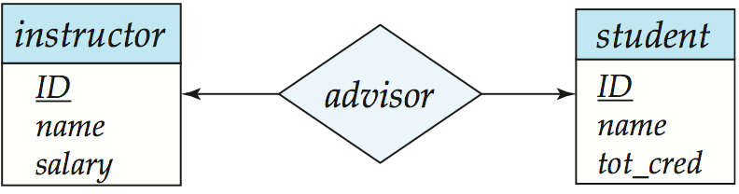

Slide 3

3. Which statement is not True? 10’
a) ODBC (Open Database Connectivity) works with C, C++, C#, and Visual Basic
b) JDBC (Java Database Connectivity) works with Java
c) JDBC does not support a variety of features for querying and updating data, and for retrieving query results.
d) JDBC also supports metadata retrieval, such as querying about relations present in the database and the names and types of relation attributes.
4. Which is the best schema for the following ER diagram? 10’
a) advisor=(s_id,i_id)
b) advisor=(s_name,i_id)
c) advisor=(s_id,i_name)
d) advisor=(s_name,i_name)

Slide 4
5. With SQL, how do you select all the records from a table named "Persons" where the value of the column "FirstName" starts with an "a"? 10’
a)SELECT * FROM Persons WHERE FirstName='%a%'
b)SELECT * FROM Persons WHERE FirstName LIKE '%a'
c)SELECT * FROM Persons WHERE FirstName LIKE 'a%'
d)SELECT * FROM Persons WHERE FirstName='a‘
6. Which design is better for a multivalued attribute M of an entity E? 10’
a) represent M in a single table
b) represent M with other attributes together
c) represent M with composite attributes
d) represent M in a relationship associated with E

Slide 5
7. An entity set is? 10’
a) a set of entities of the same type that share the same properties
b) a set of entities of different type that share the same properties
c) a set of entities of different type that share the different properties
d) none of the above
8. The set of permitted values for an attribute is called as? 10’
PS: Because the ‘value set’ isn’t mentioned in the PPT. Both b and d is right.
a) entity set
b) domain
c) value set
d) both domain and value set

Slide 6
9. If a record in table R is associated with only one record in table S, and a record in S is associated with only one record in table R, then the relationship between R and S is: 10’
a) one to many
b) many to one
c) one to one
d) many to many
10. A relationship is an association between: 10’
a) two or more entities
b) one or more entities
c) entities and attributes
d) one or more attributes

